Slide 1
Automation Tools
Learning Outcomes:
Embedded Event Manager (EEM)
Agent Based Automation Tools
Agentless Automation Tools

Slide 2
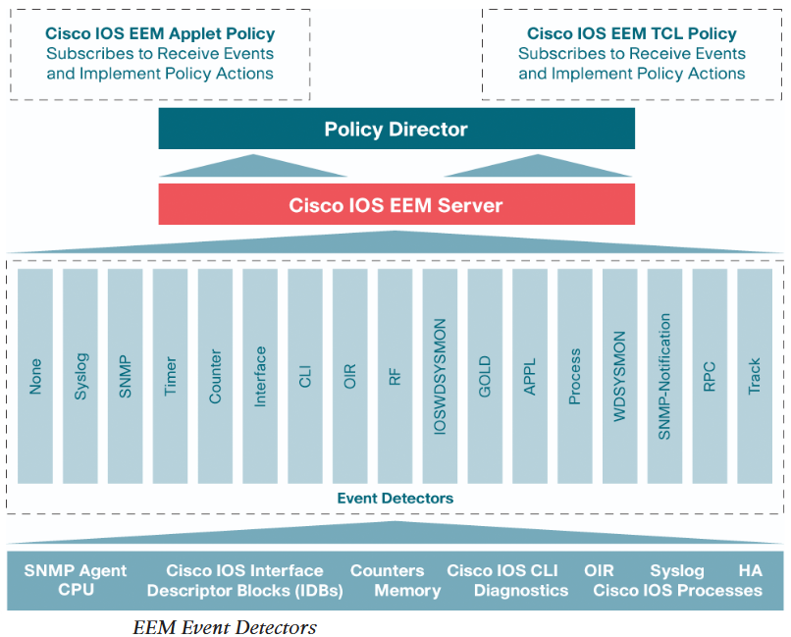
1.EEM
EEM: Event based action execution tool embedded into IOS
Can be used to build custom scripts using Tcl.
Contained in local device without any required connection to remote/external scripting and monitoring engine.
The picture shows EEM event detectors and their interaction with IOS.
EEM Applets: Based on building blocks, they follow similar logic to if-then.
Two of the main building blocks are event and action. Only one event per applet is allowed and should have at least one event defined in an applet.
For example, an EEM applet to look for interface (loopback0) up/down message can be matched(event) in syslog message using regular expression and one of the following actions can be taken:
Loopback0 interface will be shutdown and brought back up (no shutdown).
Router will generate message that says “I’ve fallen and I can’t get up”.
An email message of ‘show interface loopback0’ command output will be sent to network administrator.
Figure above shows different types of event detectors. Most commonly used are syslog, SNMP, CLI, Interface and None.
None event detector is used to manually run the EEM applet.
Two types of policy can be defined, one for EEM applet and another for Tcl scripts.

Slide 3
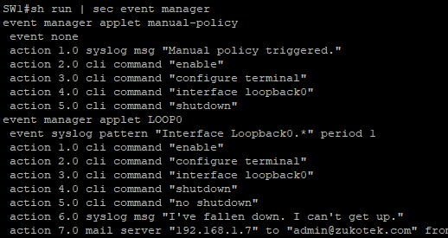
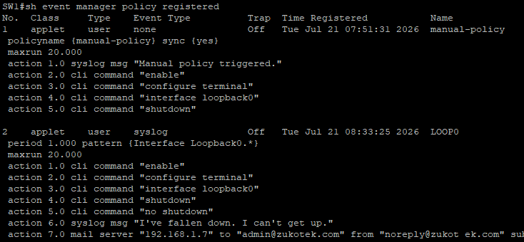
1.EEM
General EEM applet construct flow:
Register the applet with EEM using command event manager applet even-manager-name
event manager applet LOOP0
Define event criteria that will cause applet to run with event {event-detector-type} [event-detector-match-criteria] period occurrence-number.
event syslog pattern “Interface Loopback0.*” period 1
If no event and action is defined, EEM applet is removed after exiting eem applet configuration mode.
Define multiple/single actions with action label cli command cli-string [pattern cli-pattern]
action 1.0 cli command “enable”
action 2.0 cli command “configure terminal”
action 3.0 cli command “interface loopback0”
By default EEM applet opens the cli with EXEC mode, Include “enable” and “configure terminal” at the beginning of EEM applet to use privileged EXEC mode and global configuration mode.If AAA is used, include event manager session cli username username command to run EEM applet.
Pattern option is used when the command action solicits input such as ‘confirm?’
Include other actions such as sylog,mail server, snmp-trap etc.
action 4.0 syslog msg “I’ve fallen down, and I can’t getup!”
action 5.0 mail server 192.168.1.7 from no-reply@zukotek.com to admin@zukotek.com subject “Loopback Issues!” body “Loopback0 interface was bounced.Please Monitor. $_cli_result ”
The $_cli_result will include any output from cli command in the applet in email..
Verify registered EEM applet with show event manager policy registered
Two registered event manager policies. 1. manual-policy and 2. LOOP0

Slide 4
1.EEM
To debug EEM applet, debug event manager all command will debug all the actions defined in the applet.
To debug cli command only debug event manager action cli can be used.
To debug mail server issues, debug event manager action mail can be used.
Another use case of EEM applet is to backup the startup configuration to tftp server before changing it.
This is achieved by matching cli string “write memory” as event to trigger actions to copy startup configuration to tftp server.
event manager applet config-backup
event cli pattern "wr.* mem.*" sync yes period 1
action 1.0 cli command "enable"
action 2.0 cli command "configure terminal"
action 3.0 cli command "file prompt quiet"
action 4.0 cli command "end"
action 5.0 cli command "copy start $tftpserver$filename2"
action 5.1 cli command "conf t"
action 5.2 cli command "no file prompt quiet"
action 6.0 syslog priority informational msg "Configuration changed. TFTP backup SUCCESSFUL!"
SW1#show event manager environment
No. Name Value
1 tftpserver tftp://192.168.1.7/
2 filename2 SWITCH1-CONFIG
file prompt quiet suppresses the command soliciting input while working with files.
EEM environment variables that can be used across EEM applets can be set with command event manager environment variable-name variable-value
Although variable name can be set to anything, best practice is to use common names and descriptive.
Common Email variables are:
Variables | Description | Example
_email_server | SMTP server IP or DNS name | 192.168.1.7 or MAILSRV01
_email_to | Receiver email address | netadmin@zukotek.com
_email_from | Sender email address | no-reply@zukotek.com
_email_cc | Additional receiver email addresses | helpdesk@zukotek.com

Slide 5
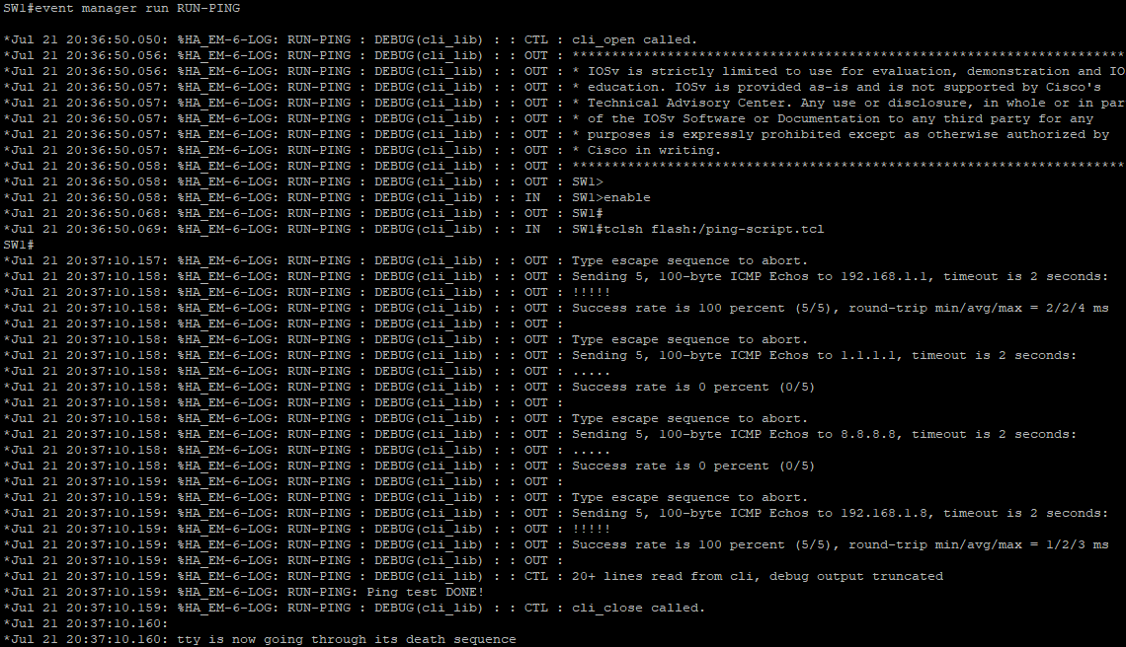
1.EEM
EEM and Tcl Scripts
EEM applets can be used to call Tcl scripts.
Tcl (Tool Command Language) pronounced “tickle” is a simple and powerful scripting language.
Running an EEM applet manually that executes Tcl script stored in router’s flash memory can be done to execute custom scripts.
Default maxrun is 20 seconds for EEM applet, if any Tcl script requires more than 20 seconds to complete, maxrun can be set with event {event-type} maxrun time such as event none maxrun 60
Example:
SW1#sh run | sec RUN-PING
event manager applet RUN-PING
event none maxrun 60
action 0.1 cli command "enable"
action 1.0 cli command "tclsh flash:/ping-script.tcl"
action 2.0 syslog priority informational msg "Ping test DONE!"
ping-script.tcl is created and edited off the router (tftp host) and copied to flash.
Content of the ping-script.tcl can be viewed in router with command more flash:/ping-script.tcl . Sample content is shown in the left. And the image shows debug event manager action cli output while manaully running the EEM applet RUN-PING
SW1#more flash:/ping-script.tcl
foreach address {
192.168.1.1
1.1.1.1
8.8.8.8
192.168.1.8
192.168.1.194
} {
puts [ping $address]
}

Slide 6
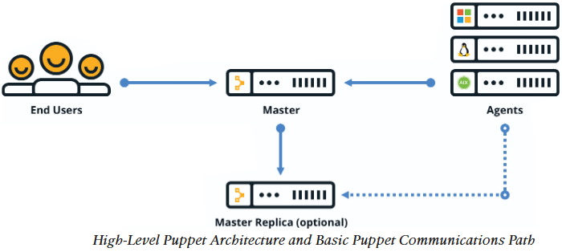
2.Agent Based Automation Tools
Automation scope
Device onboarding in an organization requires a lot of repetitive manual task.
Network automation can be achieved with EEM applets or other agent based or agentless automation tools.
Some of the common use cases for automation are:
Device name/IP address
Quality of service
Access list entries
Usernames/passwords
SNMP settings
Compliance
Puppet
Robust configuration management and automation tool.
Supported on Cisco platform such as Catalyst switches, Nexus switches, and UCS servers.
It uses the concept of puppet master (server) to communicate with puppet agent (client) installed locally on the devices.
Changes and automation tasks are performed within the puppet console and shared with puppet master and agent.
Changes and automation tasks are stored in Puppet database (PuppetDB), which can be hosted in puppet master or on a separate server.
This allows changes to be pushed to the agents at a later time.
Above is a high level Puppet architecture with basic communication path.
Solid lines show the primary path of communication and dotted lines show optional path (high availability).
Communication between master and agents is through TCP connections and each TCP port uniquely represent an agent on a device or node.
Puppet can periodically verify the configuration on the node and revert back to previous configuration if required.

Slide 7
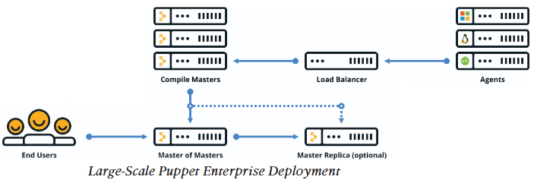
2.Agent Based Automation Tools
Puppet Deployment options
Although Puppet is very scalable, typical and recommended deployment option is monolithic with upto 4,000 nodes.
In large scale deployments, deployment architecture shown below is generally adopted.
A Master of Masters (MoM) is required to properly manage distributed masters known as Compile Masters and their associated database.
Compile Masters are the load balanced Puppet Masters to support large scale agents.
Installation Type | Scale
Monolithic | Up to 4,000 Nodes
Monolithic with compile masters | 4,000 to 20,000 Nodes
Monolithic with compile masters & standalone PE-PostgreSQL | More than 20,000 Nodes
Puppet structure contains modules that can configure anything that can be configured manually.
Puppet includes modules for different vendors and device types. Such as cisco_ios module.
Components of Puppet modules are:
Templates, Files and
Manifests: They are the configuration codes that are pushed to agents over a secure SSL connection (requires certificate to be installed) between Masters and Agents.
Puppet manifests files are code files with .pp extension that modifies running configuration on nodes.
Puppet leverages Domain Specific Language (DSL) as its ‘programming language’ based on Ruby.
Puppet documentation, installation guides, community and sample manifests can be found on https://forge.puppet.com/.

Slide 8
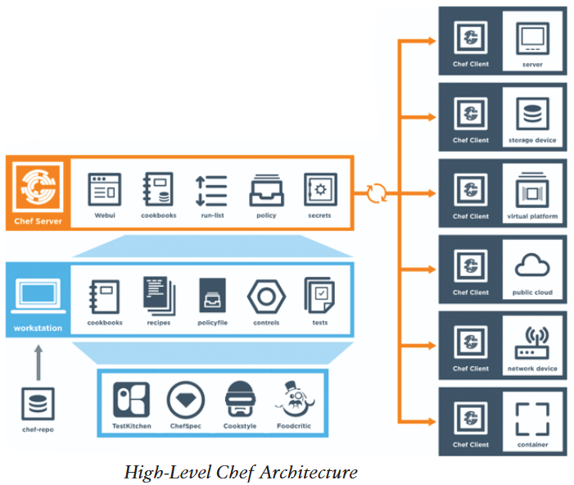
2.Agent Based Automation Tools
Example Puppet manifests
NTP_Server.pp manifest
ntp_server{‘1.2.3.4’:
ensure => ‘present’,
key => 94,
prefer => true,
minpoll => 4,
maxpoll => 14
Source_interface => ‘Vlan 42’ ,
}
NTP server address is configured as 1.2.3.4 and source interface of Vlan 42 is used.
The line ensure => ‘present’ indicates that the NTP configuration should be present on the running configuration of the ios device where the Puppet Agent is running.
Chef
Configuration management tools work in two models, Push and Pull.
Push models push configuration from centralized management tool or server to the remote device.
Pull models check in with the centralized tool or management server to pull the changes in configuration (updated files) to the remote device.
Both Chef and Puppet work in pull model and has a client/server architecture.
Both have free open source versions and paid enterprise versions available.
Although both have client/server architecture, Chef overall architecture is different than Puppet.

Slide 9
2.Agent Based Automation Tools
Puppet and Chef Comparison
Once the recipe is created in workstation, it must be uploaded to the server to be used in the environment.
Knife is the command-line tool used to upload cookbooks to the server and is uploaded using command knife upload cookbook-name
Four types of Chef server deployments:
Chef Solo : Server hosted locally on the workstation.
Chef Client and Server : Typical deployment scenario with distributed components.
Hosted Chef : Server hosted in the cloud
Private Chef : All the components are within the enterprise network.
Chef Components | Puppet Components | Description
Server | Master | Server/Master functions
Client | Agent | Client/Agent functions
Cookbook | Module | Collection of code or files
Recipe | Manifest | Code being deployed to make configuration changes
Workstation | Console | Where users interact with configuration management tool and create code
OHAI, a service that is installed on the client is used to collect the current state of a node to send information back to the Chef server through Chef client service.
Chef server compares the information sent by OHAI with the cookbooks and recipes stored in it.
When a node needs recipe, Chef client handles the communication with Chef server about nodes requirement of updated configuration or recipe.
Chef itself is written in Ruby and Erlang languages, whereas the recipes are written in Ruby with filename extension ‘.rb’ .
All recipes and cookbooks examples can be found on GitHub.
With Chef, kitchen is the place (test environment) where recipes and cookbooks can be tested before deploying into production environment.
With kitchen testing can be done within the enterprise environment or across public cloud providers and virtualization technology.

Slide 10
2.Agent Based Automation Tools
SaltStack (Agent and Server Mode)
Another configuration management tool that is built with Python and has Python interface for users to code.
However most of the states and instructions that are sent to the agents known as Salt formulas are written in YAML or DSL.
SaltStack uses the concept of systems, which are divided into various categories.
Similar to Puppet master and agent, SaltStack uses Masters and Minions.
SaltStack leverages distributed messaging platform called 0MQ (zeroMQ) for fast and reliable messaging through out the networking stack.
It is an event driven technology that has reactors and beacons.
A Reactor is on the masters and listens for any type of changes in nodes or device that differ from the desired state or configuration.
Beacons live on minions (similar to Puppet agents).
A process where beacon on minions notifies reactors on masters about the state or configuration changes is known as remote execution system.
Any command issued from masters to minions is known as job.
Instead of modules and manifests in Puppet, Saltstack uses pillars and grains.
And similar to Chef’s OHAI, SaltStack grains that live on minions, collect system state to send back to masters.
Pillars on the other hand lives on masters and store data that minions can retrieve.
Pillars can also have certain minions assigned to it and it stores data that is needed to those minions only.
Confidential and sensitive information that can be shared with specific minions only can be secured by assigning specific minions to pillars that store such data.
SaltStack is also very scalable and can be deployed in very large scale.
It has a GUI called SynDic for enterprise version, which can be used as master of masters in large deployments.

Slide 11
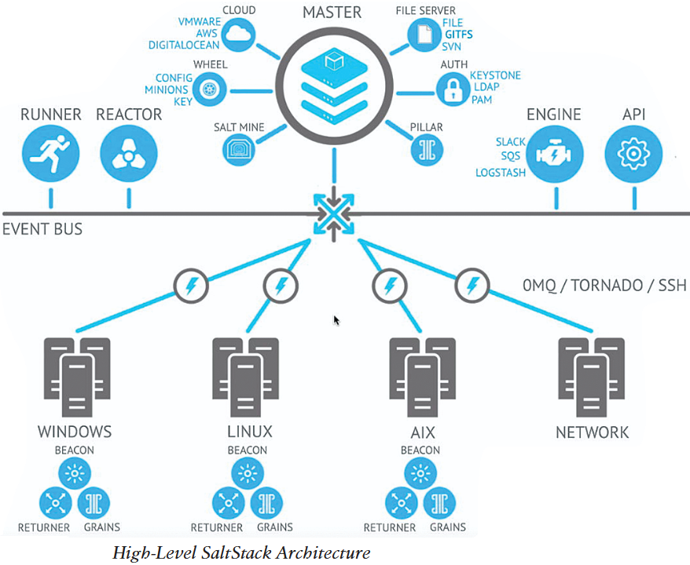
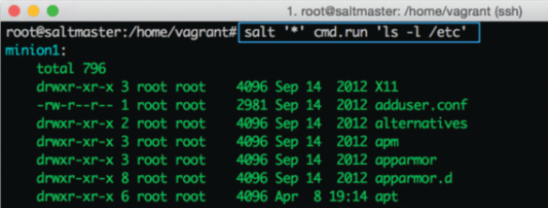
2.Agent Based Automation Tools
SaltStack command structure contains targets, commands and arguments.
Target is the desired system that the command should run.
Any system can be specified as target with MinionID.
It’s common to target all systems with asterisk (*) and globbing can be used to specify selective systems as targets.
For example with globbing, to target systems that has MinionID starting with Minion can be done with Minion*.
Commands follow structure module.function such as cmd.run and network.interfaces
Arguments are like normal argument that provides details to the commands.
In a SaltStack command, salt ‘*’ cmd.run ‘ls -l /etc’ , ‘*’ is the target (all systems), cmd.run is the command and ‘ls -l /etc’ is the argument.
This would list contents of /etc folder on all systems as follows:
For a task, where ip addresses of network interface needs to be listed on all systems, command salt ‘*’ cmd.run ‘ ifconfig’ could be used as in previous command. Passing actual command as argument to SaltStack command.
Rather, using a more specific command such as salt ‘*’ network.interfaces is recommended.

Slide 12
3.Agentless Automation Tools
Ansible
Automation tool that can be used for cloud provisioning, application deployment and configuration management.
As it is agentless, no client or agent needs to be installed on devices/nodes that needs to be managed.
Ansible mostly uses SSH to manage remote nodes and also supports Windows Remote Management (WinRM) among other transport methods.
While automation in general makes it easy to manage infrastructure at scale, it equally impacts the infrastructure in scale if any error in code or process.
Therefore, a common method of Prepare, Plan, Design, Implement, Operate and Optimize (PPDIOO) lifecycle should be used.
Components of Ansible:
Ansible playbooks are written in YAML and although it’s optional it is common to start with three dashes (---) and end with three dots (…)
YAML uses list and dictionaries and lines
starting with hash (#) are comments.
Each line of list can start with a dash and a
space (- ).
YAML dictionaries use key:value and are similar to JSON dictionaries “key”: ”value” .
YAML Lint is a free online tool to check the validity of YAML file.
Below example contains dictionary with list in it.
---
# HR Employee Record
- Employee1:
name: Alice
Title: Security Engineer
Nickname: Ms. Sender
Skills:
- Python
- Cryptography
- YAML
- Employee2:
name: Bob
Title: Security Engineer
Nickname: Mr. Receiver
Skills:
- Python
- Cryptography
- YAML
Ansible Components | Description | Use Cases
Playbook | Re-usable set of plays | Enforcing configuration and/or deployment steps
Play | A set of task applied to a host or group of hosts. | Grouping a set of hosts for applying or enforcing configuration to them.
Task | A call to Ansible module | Logging into a device to issue show command to retrieve output.
Inventory | Single file in INI or YAML format containing list of hosts or group. | Run commands or playbooks on inventory file.

Slide 13
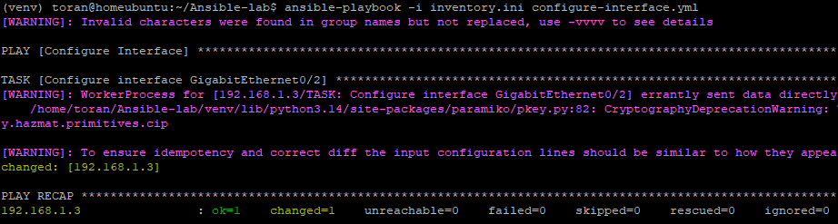
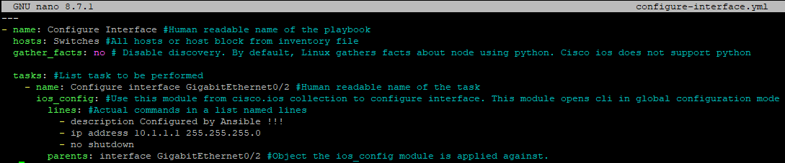
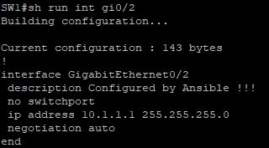
3.Agentless Automation Tools
Ansible CLI commands (Control Node):
ansible-doc -l cisco.ios would list all the modules available in cisco.ios collection.
Ansible inventory file contains named group of hosts or simple list of hosts.
A host can belong to multiple group and can be identified with resolvable DNS name or IP address.
An example inventory file is shown in the left and an example playbook, configure-interface.yml is shown below:
Commands | Use Case
ansible | Runs modules against targeted hosts
ansible-playbook | Runs playbooks
ansible-docs | Provides documentation on syntax and parameters on CLI
ansible-pull | Changes ansible clients from default push to pull model
ansible-vault | Encrypts YAML files that contains sensitive data
Example: Inventory.ini
[Routers]
192.168.1.3
192.168.1.20
192.168.1.30
[Switches]
192.168.1.3
10.10.10.2
[Primary-Gateway]
192.168.1.1
To execute playbook, ansible-playbook -i Inventory.ini configure-interface.yml is used.

Slide 14
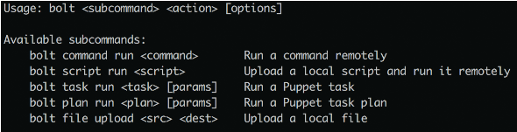
3.Agentless Automation Tools
Puppet Bolt
Puppet Bolt allows to leverage power of Puppet without the need to install Puppet agent.
Like Ansible, it also uses SSH and WinRM to connect to the devices.
Puppet Bolt tasks can be used to push configuration, start/stop services and deploying application.
Tasks are shareable and can shared on Puppet Forge
Puppet Bolt can be used in two scenarios:
Orchestrator-driven Tasks: Leverages Puppet Bolt architecture to connect and manage nodes. Ideal for large deployments.
Standalone Tasks: Connects directly to managed nodes without requiring Puppet components
Individual puppet commands can be run from the Puppet command line using bolt command run command-name followed by the list of devices to run the command against.
In addition, a script in any scripting language that a managed node can interpret (ex. Python, Ruby) can be run using command bolt script run script-name followed by device list.
To run a script, Puppet bolt copies the script to remote device, runs it, captures the output and removes the script leaving the device clean.
Above picture shows some of the commands available with Puppet Bolt.
Puppet Bolt uses API to collect data and run tasks.
Tasks are part of Puppet module and uses naming structure modulename::taskfilename
Tasks can be run with bolt run task modulename::taskfilename
Puppet tasks are accompanied with metadata file in JSON format, generally named with same name as task, that contains details such as how to run the task.
Documentation about the task script can be viewed with bolt task show modulename::taskfilename

Slide 15
3.Agentless Automation Tools
SaltStack SSH (Server only)
Agentless option of SaltStack called Salt SSH that do not require minions to be installed on manged nodes.
To be able to use Salt SSH, managed nodes need to have SSH enabled and Python installed.
Salt SSH creates a temporary directory to install lightweight version of SaltStack on managed node which it deletes after the operation or optionally can be left in the device for future use.
Salt SSH can be used in conjunction with SaltStack environment or by itself.
Salt SSH uses roster files (similar to ansible inventory file) to manage connection information for devices that do not have minions installed.
Salt SSH is comparatively slower than using 0MQ messaging in SaltStack and faster than direct SSH into the device.
A sample Salt SSH Roster File would look like below:
managed:
host: 192.168.1.3
user: admin
Automation Tools Comparison
Feature | Puppet | Chef | SaltStack | Ansible
Architecture | Masters and Agents | Server and Client | Master and Minions | Control Centre Station and Remote hosts
Language | Puppet DSL | Ruby DSL | YAML | YAML
Terminology | Module and Manifests | Cookbooks and Recipes | Pillars and Grains | Playbooks and Plays
Large Scale deployment support | Yes | Yes | Yes | Yes
Agentless Version | Puppet Bolt | N/A | Salt SSH | Yes
Important factor in choosing an automation tool is the skills/language the operation staff are comfortable with.

